Slide 1
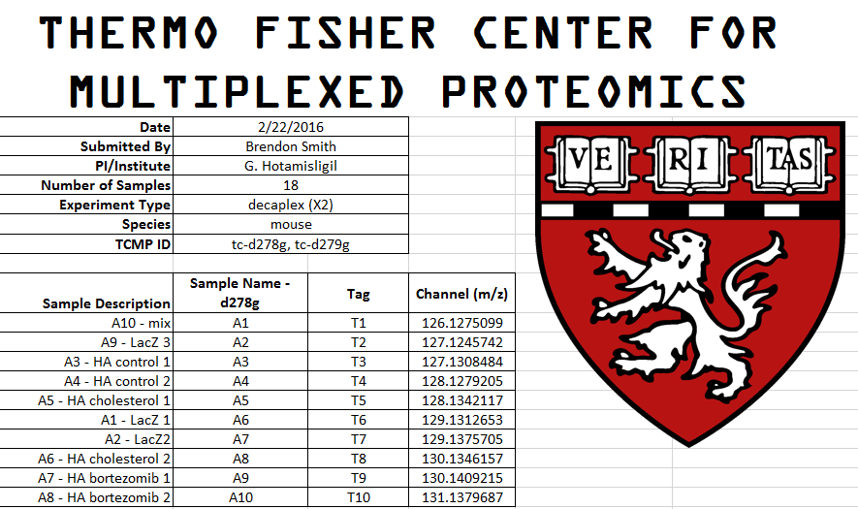
Final report for Brendon Smith
TMT10 quantitative gel protein profiling experiments

Slide 2
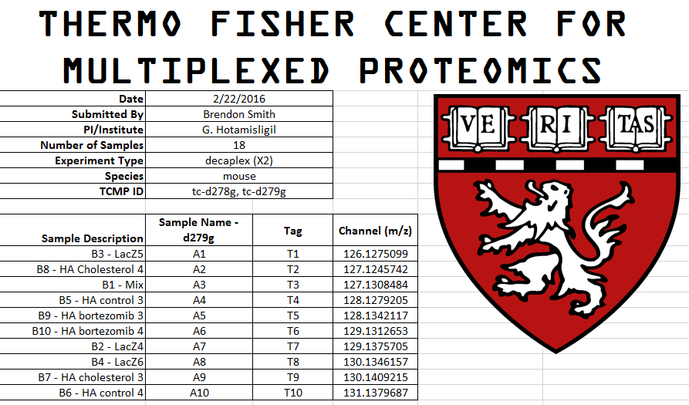
Final report for Brendon Smith
TMT10 quantitative gel protein profiling experiments

Slide 3
Experimental workflow
Pg. 3
Gel
Search, filter
&
compile data
Pg. 3
Digest
Pgs. 6-9
Pgs. 4
Label Peptides
LC-MS3
Pg. 5
Combine Samples

Slide 4
Sample Preparation
Samples were submitted in gel loading buffer. 5µl of each sample was combined for the “mix” sample to be included in both experiments. 30µl of each sample was loaded into 10% Bis/Tris gels and run at 120V for 12 minutes. Gels were stained for 2 hour with Coomassie and destained overnight in water. No bands were visible in tc-d279g gels. Remaining sample was loaded into new gels, stained, and destained overnight.
Tc-d278g
A1 A2 A3 A4 A5 A6 A7 A8 A9 A10
Tc-d279g
A1 A2 A3 A4 A5 A6 A7 A8 A9 A10
Gel bands or approximate areas were cut out, destained, reduced, and alkylated. In-gel Trypsin digests were performed and peptides were extracted and labeled with TMT10 reagents. Labeling reactions were combined, cleaned, and dried down. Peptides were resuspended in 5% Acetonitrile, 5% formic acid and ½ of the sample was shot on an Orbitrap Fusion Mass spectrometer.

Slide 5

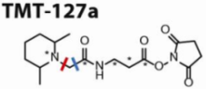

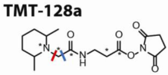



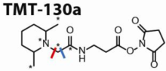


Tandem Mass Tags for Multiplexed Proteomics
2 3 4 5 6 7 8 9 10
Precursor ion (MS1 scan)
Reporter ion quantification
(MS3 scan)
Peptide Sequencing
(MS2 scan)
m/z
m/z

Slide 6
MS analysis
Peptides were analyzed on an Orbitrap Fusion mass spectrometer
Peptides were separated using a gradient of 6 to 28% acetonitrile in 0.125% formic acid over 180 minutes.
Peptides were detected (MS1) and quantified (MS3) in the Orbitrap
Peptides were sequenced (MS2) in the ion trap.
MS1 peptide ion chromatogram
Normalized intensity
Time

Slide 7
Protein Normalization
Protein Quant data is provided in two forms, raw signal to noise and globally normalized.
For normalized data, normalization factors are calculated based on the total summed
signal to noise in each TMT channel.
Normalization was performed within each gel, but not between them.
The large normalization factors for tc-d278g are due to the large difference in intensity
between the second gel band compared to the other samples.
Normalization Factors
 | A1 | A2 | A3 | A4 | A5 | A6 | A7 | A8 | A9 | A10
d178g | 4.3 | 1 | 7.7 | 7.0 | 6.8 | 8.2 | 12.3 | 5.3 | 6.7 | 5.3
d179g | 1 | 3.8 | 3.5 | 3.6 | 1.7 | 2.8 | 1.8 | 2.2 | 2.4 | 2.5

Slide 8
A summary of peptide and protein numbers
MS2 spectra were searched using the SEQUEST algorithm against a Uniprot composite database derived from the mouse proteome containing its reversed complement and known contaminants. Peptide spectral matches were filtered to a 1% false discovery rate (FDR) using the target-decoy strategy combined with linear discriminant analysis.
The proteins were filtered to a <1% FDR
Proteins were quantified only from peptides with a summed SN threshold of >=200 and MS2 isolation specificity of 0.5
d278g
Total Peptides (<1%)
5,747
Total Proteins (<1%)
788
Total Collapsed Proteins
719
Quantified Proteins
571
d279g
Total Peptides (<1%)
3,719
Total Proteins (<1%)
618
Total Collapsed Proteins
572
Quantified Proteins
449
FDR percentages are shown in parentheses. Quantified Proteins do not include contaminants or reverse hits.

Slide 9
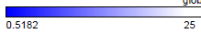
Hierarchical Clustering – Normalized Data
571 quantified proteins
449 quantified proteins
%Relative Abundance
Clustering was performed using the one minus Pearson Correlation method.
0
20

Slide 10
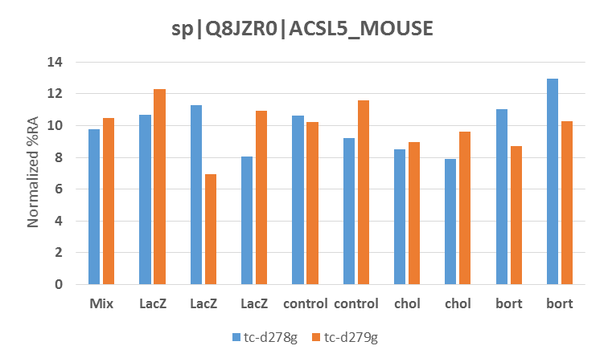
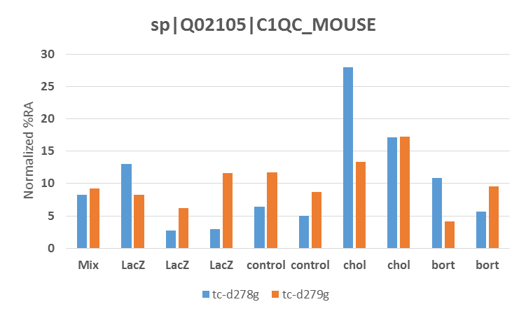
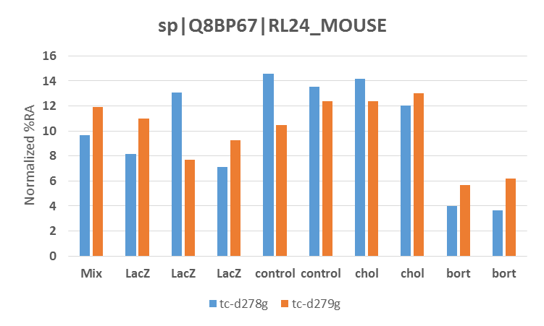
Example Individual protein profiles
Expression is the same across all samples
Possible increase in Cholesterol Samples
Decreased in Bortezomib samples

Slide 11
Data file summary
Protein quant data is included as an excel spreadsheet. Quantitative data is provided in two forms: 1) total summed intensity of peptides assigned to each protein and 2) normalized relative abundance
Please use caution with proteins quantified by one peptide only!

Slide 12
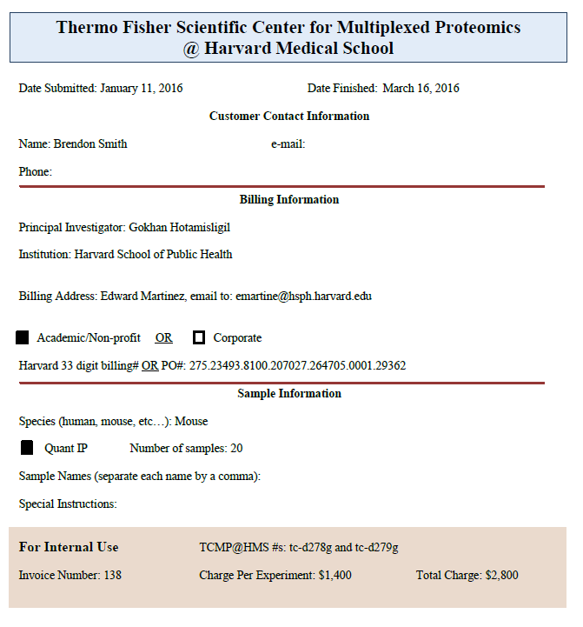
Final report for Smith, B. – TMT10 quantitative gel protein profiling experiments

